Slide 1
HOSTEL MANAGEMENT SYSTEM
Team Member:-
JIGAR D PATEL (1BM21CS081) KRISHN MALOO (1BM21CS092) KSHITIJ S (1BM21CS093)

Slide 2
introduction
In this Project “Hostel-Management System”, we have made an effort to make the Hostel-System of BMSETH online. Our website includes exclusive features for Hostelers like Hostel leave application forms, Suggestion box, Complaint box, personalized dashboard etc. We also have information about Hostel facilities like Hostel Events, Mess, Accommodation and Admissions, Code of Conduct, Anti-ragging norms etc.

Slide 3
Motivation
Our major advantages can be summarized as follows:
Easy Access
Making Hostel- Website online would ensure easy access to hostel-facilities to both Freshers seeking admissions into BMSETH and presently residing hostellers in campus.
Easy Payments Options
Presently Hostel accepts payments only in offline mode, This project will help making transactions online and henceforth there will be easier and smoother payments.
Easy Communication:
Communication among hostelites, Hostel admins and Guardians.
Reactive:
Presently BMSETH website is not reactive, In this website, the data will be regularly updated.

Slide 4
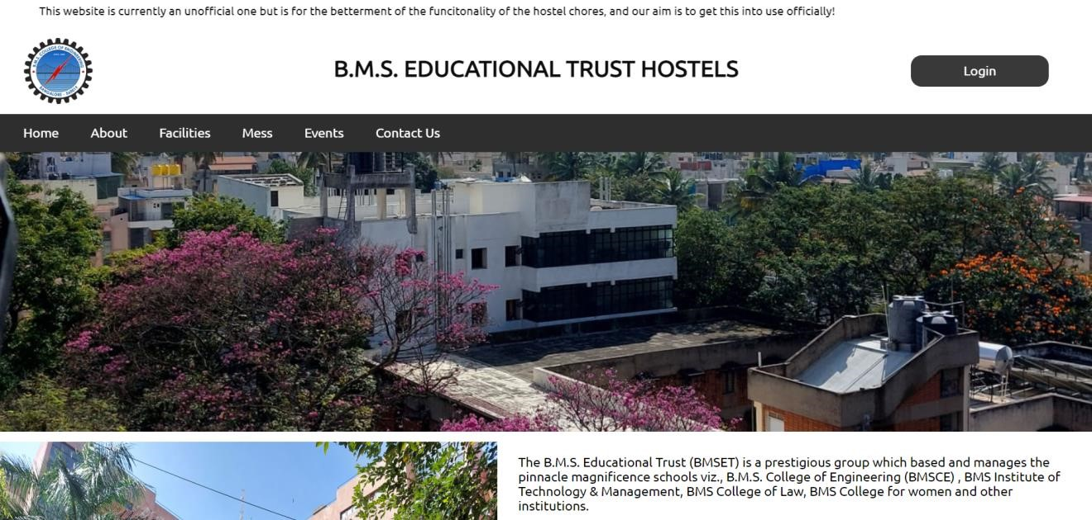
Home page-Header
1.The page is divided using <div> tags.
2.The page is divided into three parts – header, main body and footer.
3.Header contains floater, title and login button along with navigation bar and followed by an image.
4.The body contains a brief introduction/description about hostels.

Slide 5
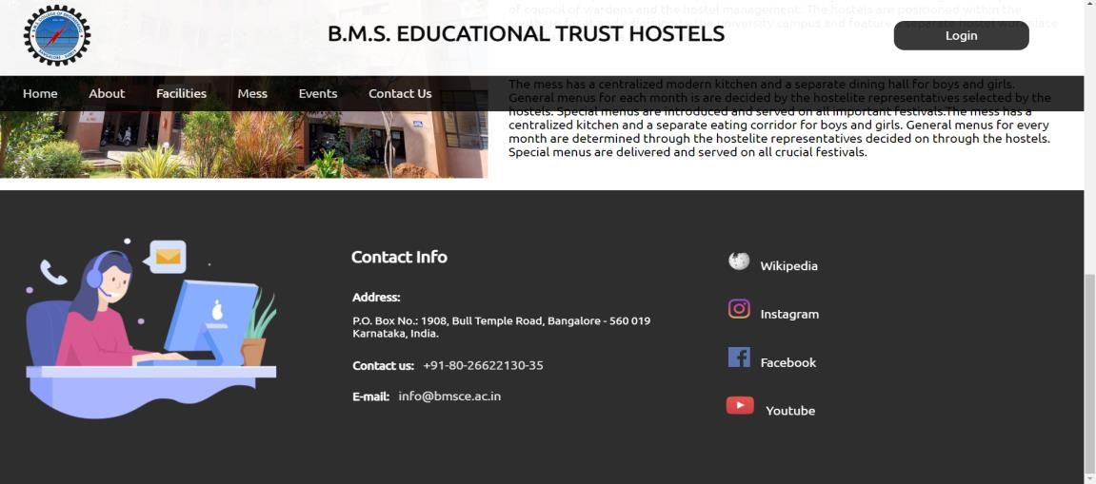
Home-Footer
• The footer contains contact information and is divided into three sub parts containing an image, contact information and social media handles respectively.

Slide 6
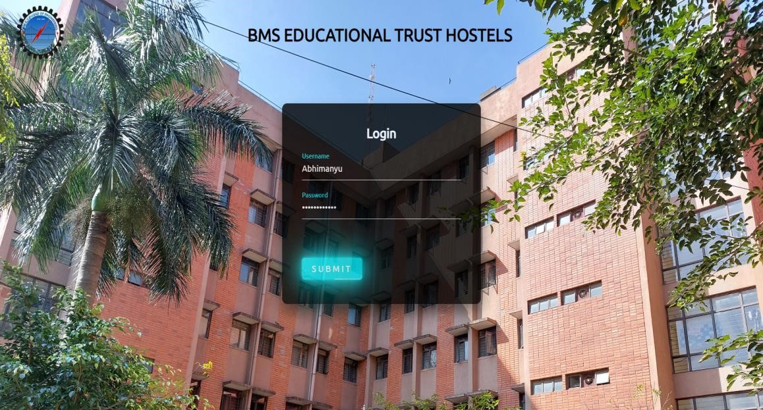
Login Page :-
1.Hostelites should sign-in to view details/status of their accommodation and services by Hostel
2.Username and password should be entered by the student to login.
3.The submit button on clicking/hovering changes its properties.
4.The page validates if a valid username is entered and displays a pop-up when login is successful.

Slide 7
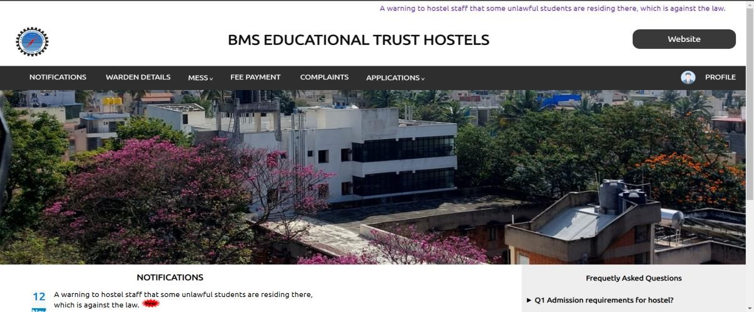
After Login-Page :-
1.This is the page user reaches after logging in.
2.This page is divided into two parts header and body.
3.The header contains logo, title and button which directs back to main website along with a navigation tab with link to different pages.

Slide 8
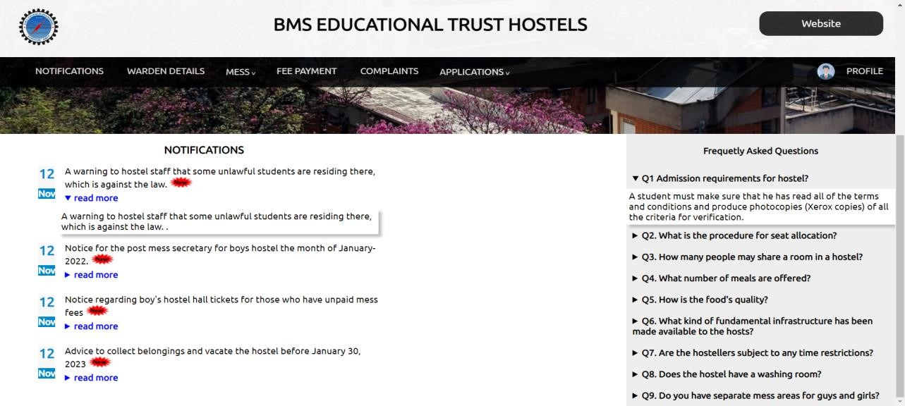
1.Body is divided into two parts one contains the notification along with date and summary tag is used here to provide an option to read more about a particular notification.
2.Similarly, the other part has FAQs and summary tag is used here also.

Slide 9
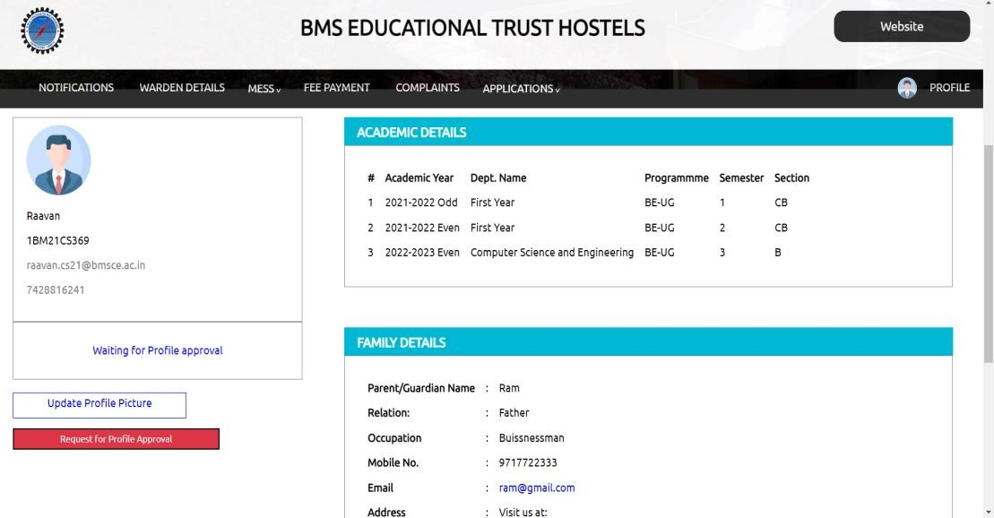
Student-Detail Page (Profile) :-
1.Tab contains personal and academic information of the student.
2.The page is divided using <div> tags and there are options to change profile photo as well.
3.Displays academic history, family background, hostel room details etc.

Slide 10
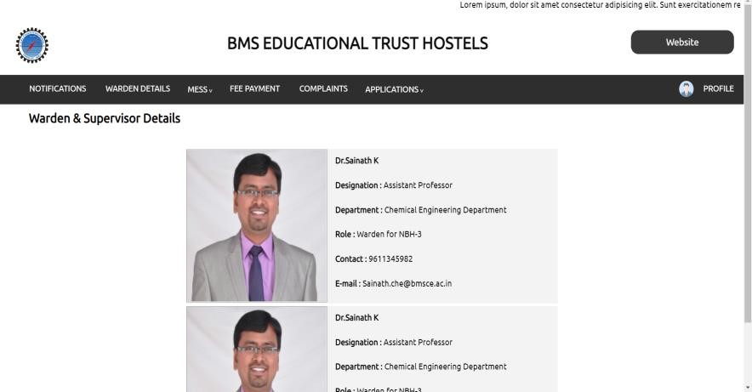
Warden Details Tab :-
1.Following page displays details of warden and supervisor.
2.Contains contact information of the warden and supervisor.
3.Page is divided using <div> tags.

Slide 11
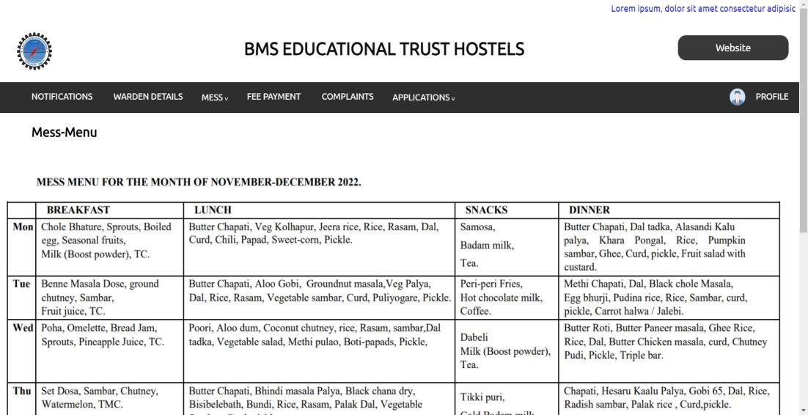
Mess:-
1.Contains two dropdown options – menu and suggestion form.
2.Menu page contains the menu in .jpg form.
3.Suggestion form takes in suggestions for the menu based on day and meal.

Slide 12
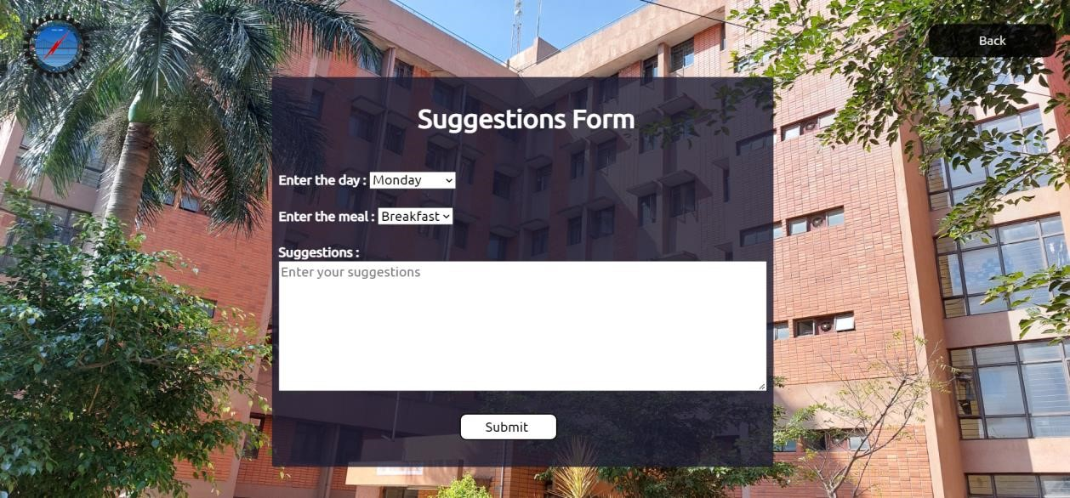
Suggestion Form :-
1.Suggestion form also checks for cases which aren’t possible, for instance user selects “Saturday dinner” or “Saturday snacks” which isn’t correct as snacks and dinner are not provided on Saturday.
2.Also, it checks if suggestion is invalid or not

Slide 13
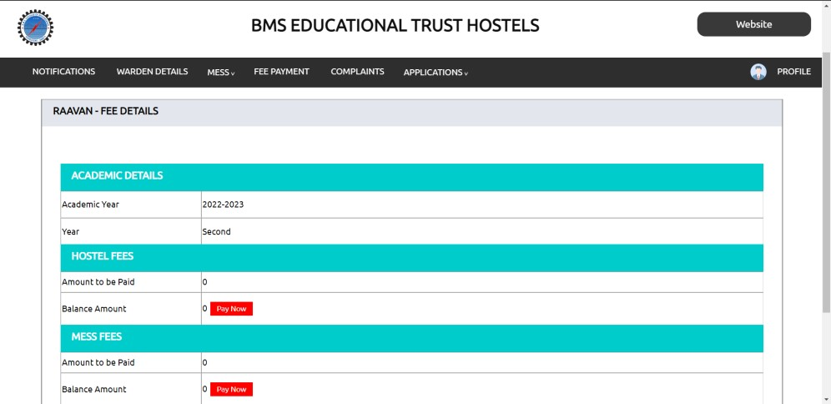
Fee-Payment :-
1.The following tab displays fee details of the student and provides an option/button to pay it online.
2.Contains information about hostel fee, mess fee and late fee (if any).
3.The page is created using <div> tag and table tag.

Slide 14
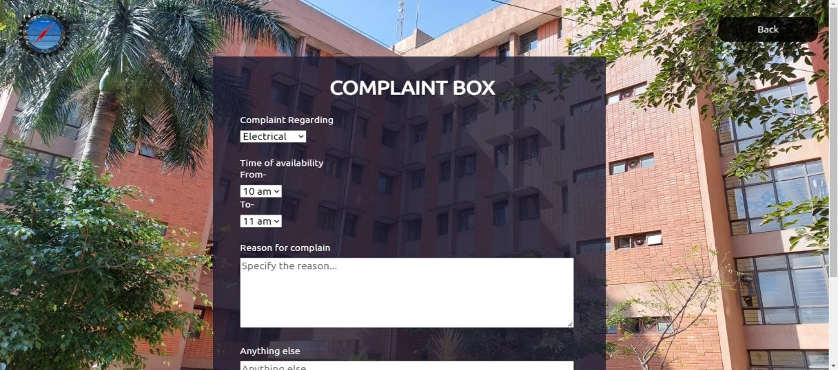
Complaint :-
1.The following page takes in the general complaints from hostelites, taking in details about time of availability and the reason.
2.The page is created using form tag and takes input from the users along with checking if the time of availability is appropriate, mobile number is correct and the reason entered is valid.

Slide 15
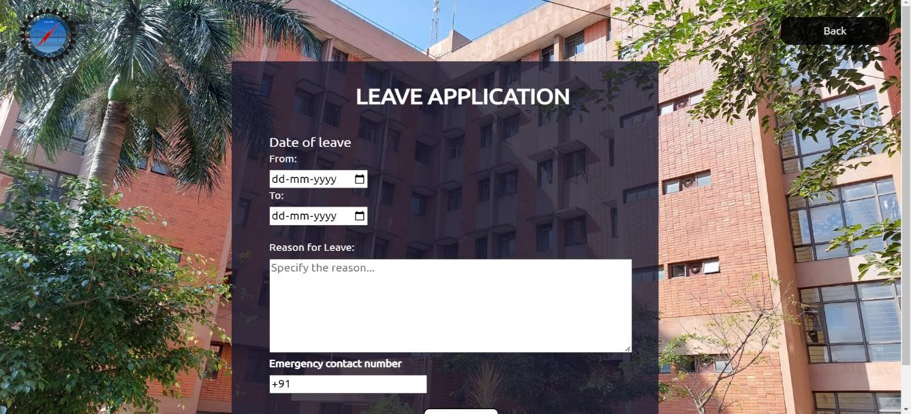
Leave Application :-
1.The following page takes in the information about the duration of leave, reason for leave and emergency contact number from the user.
2.It checks for if the duration entered is correct, the reason is valid and a valid contact number is entered or not.

Slide 16
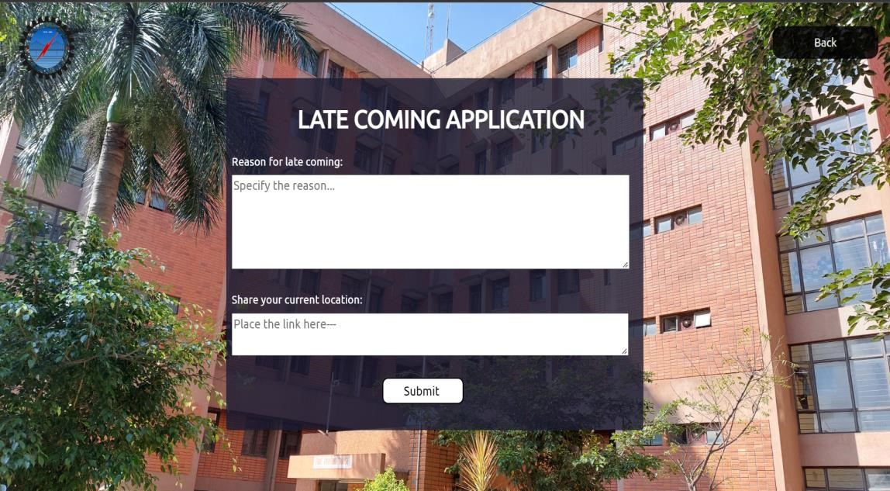
Late Coming Application :-
1.Following tab helps the user to put in a late coming application taking in inputs about the reason and the current location.
2.It checks if a valid reason is entered and a valid link is shared or not.

Slide 17
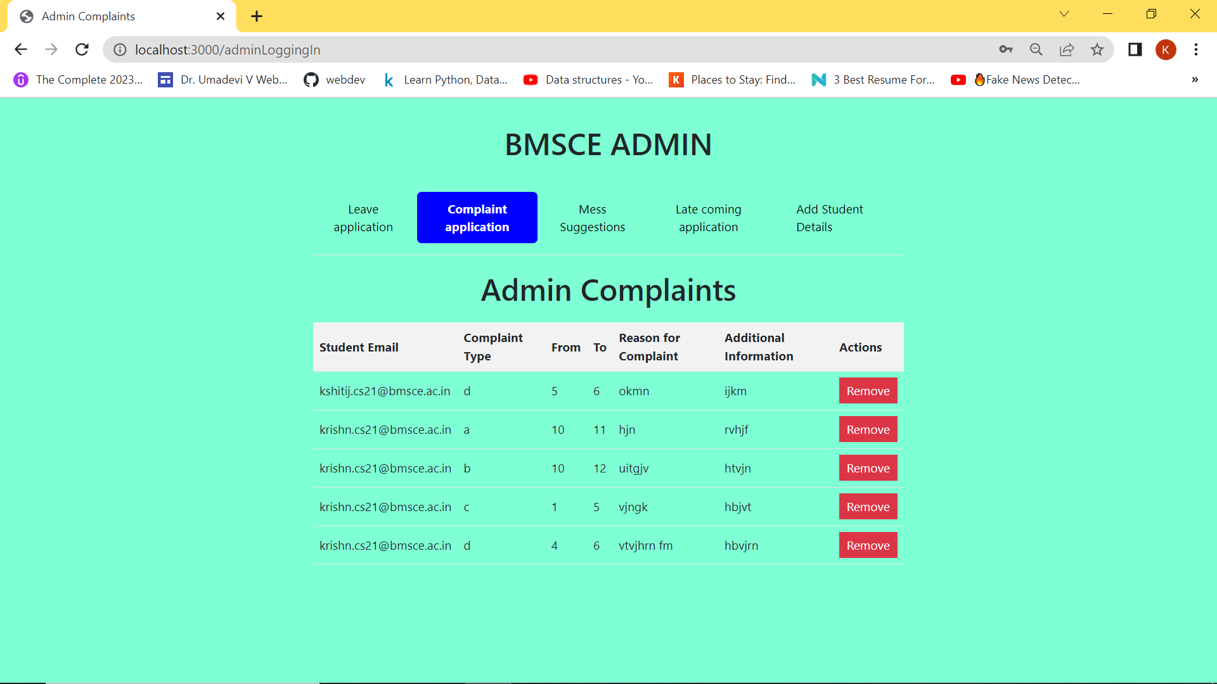
BMSCE ADMIN
1.The page is divided using <div> tags.
2.The page is divided into wo parts – header and main body.
3.Header contains leave application, complaint application, mess suggestion, late coming application and to add student details form.
4.There are current and unresolved complaints in the body.

Slide 18
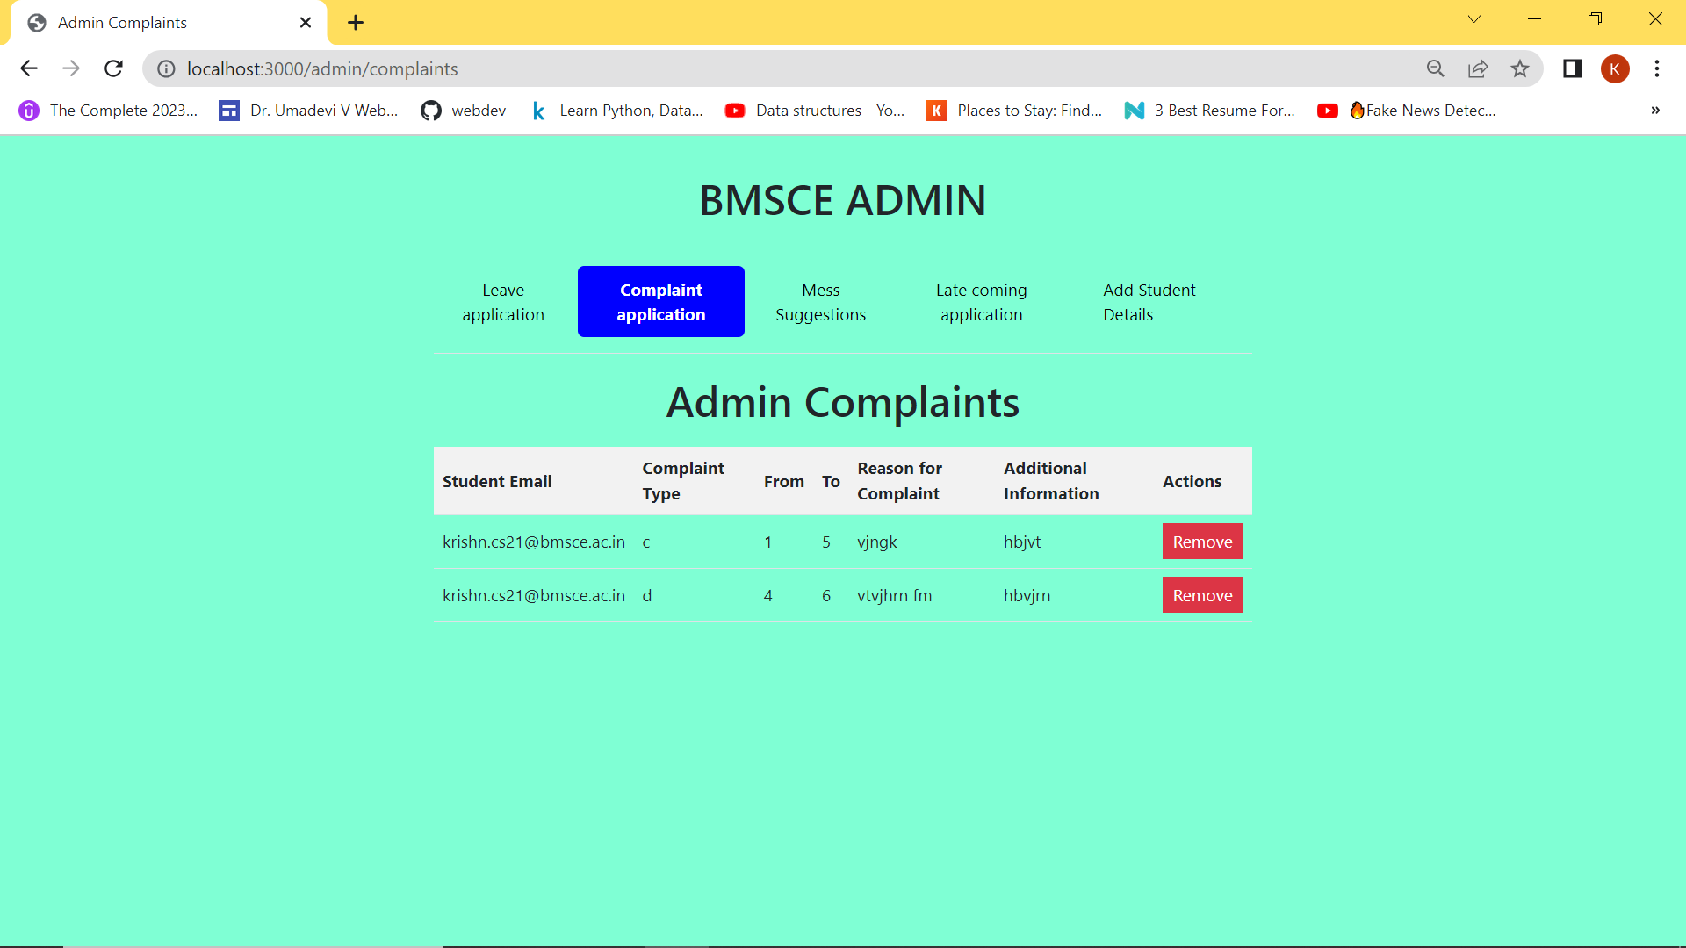
1.Once the issue has been resolved, the administrator may delete the complaint by using the remove button.

Slide 19
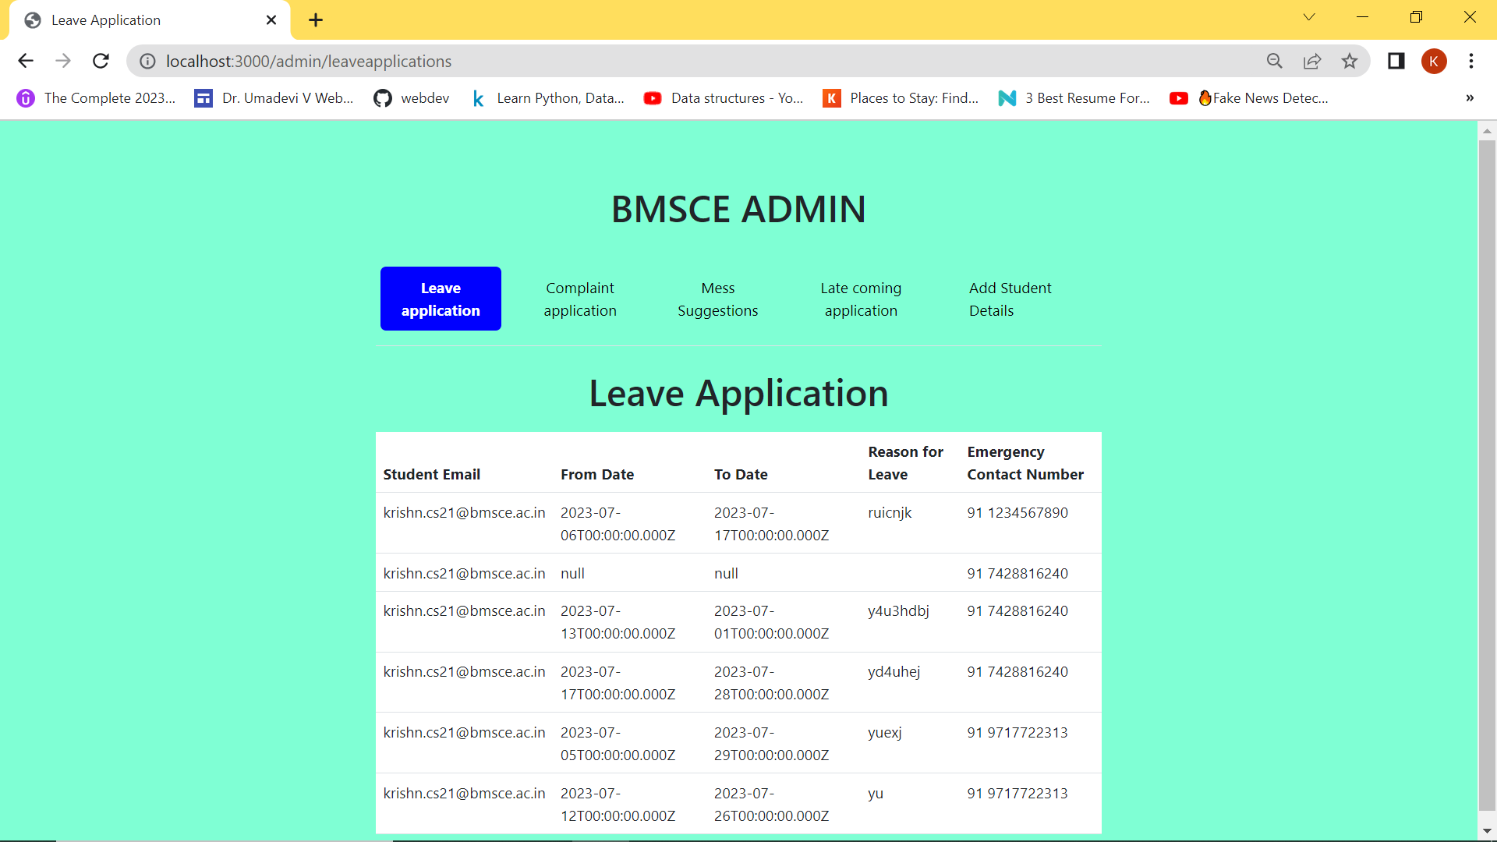
LEAVE APPLICATION
1.The following page gives the information about leave application.
2. It displays information about the pupils who recently took leave.
3.Leave application contain student email, from-date, to-date, reason for leave and emergency contact number.

Slide 20
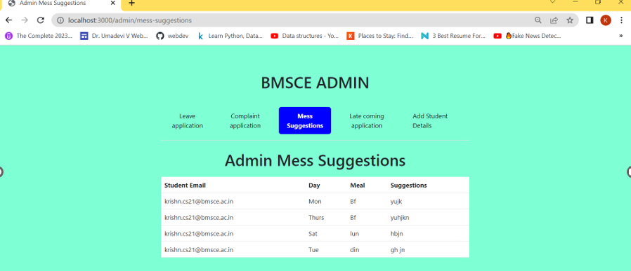
ADMIN MESS SUGGESTIONS
1.The following page gives the information about Mess Suggestion.
2.It displays information about students’ email, Meal-day, meal and Suggestion

Slide 21
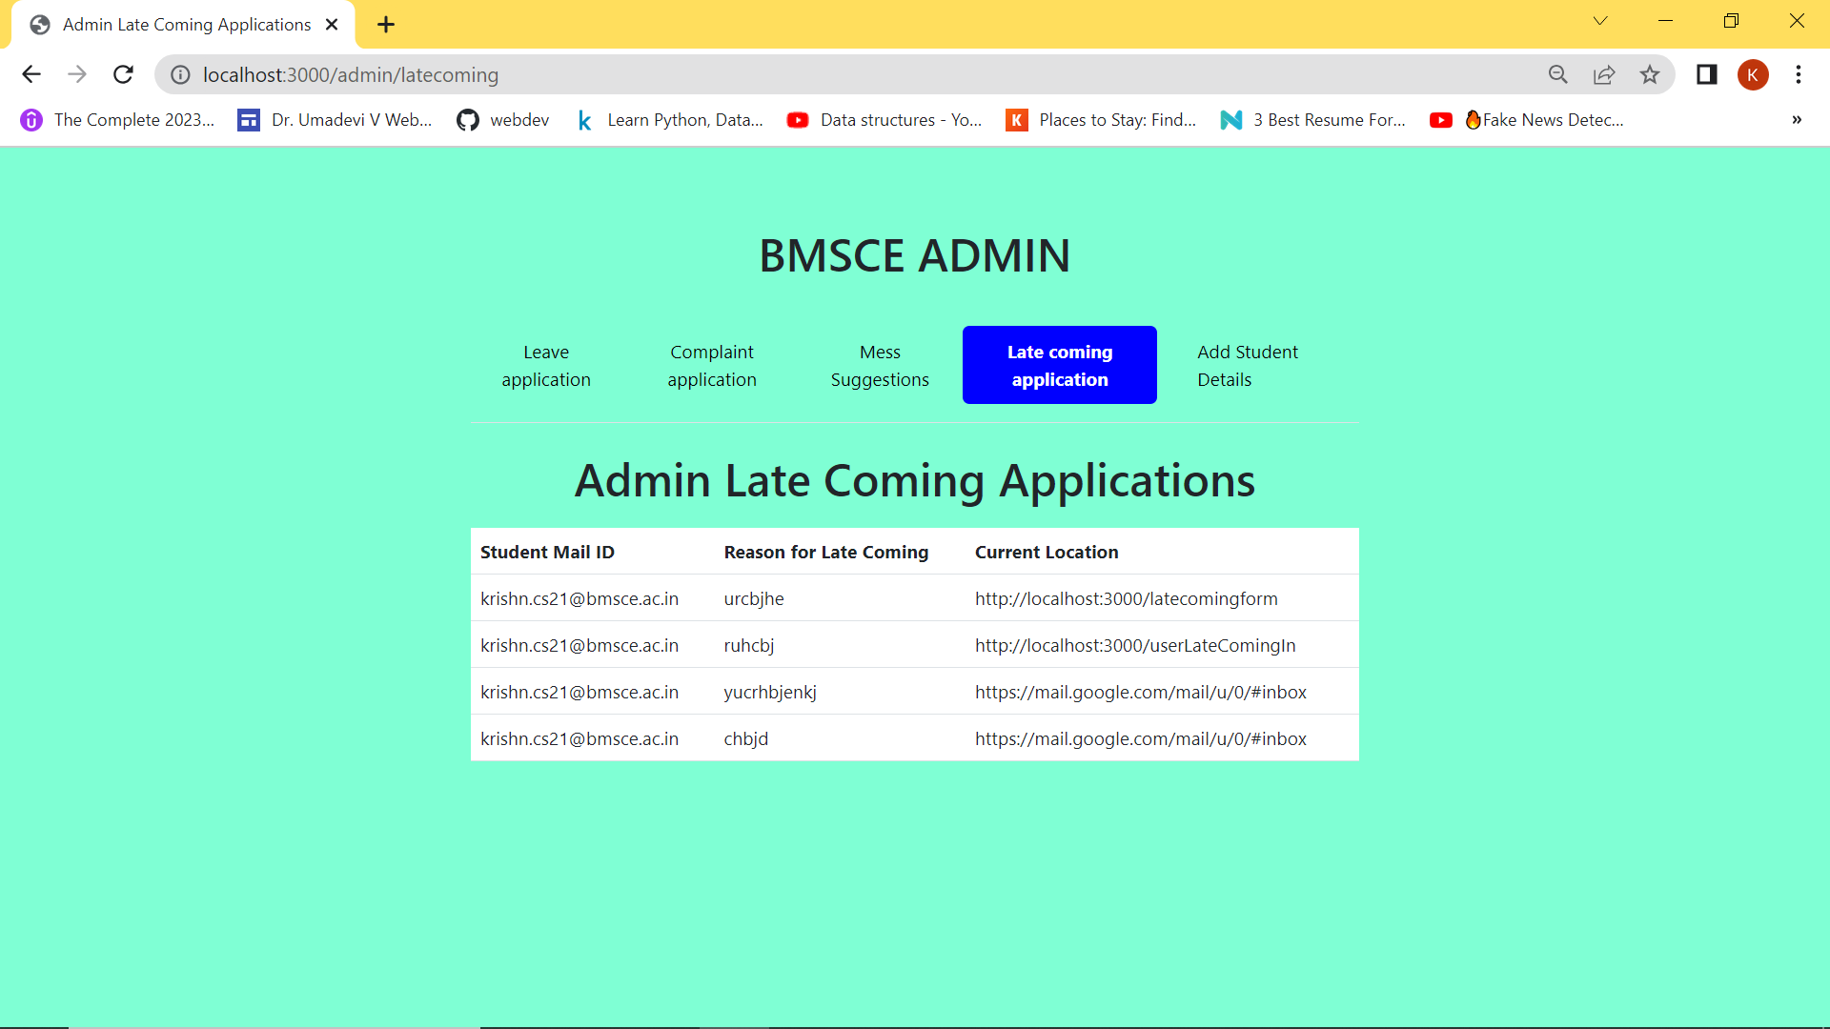
ADMIN LATE COMING APPLICATION
1.This page provides information on all of the students that submitted late applications.
2.It include information like student mail id, reason for late coming and current location.

Slide 22
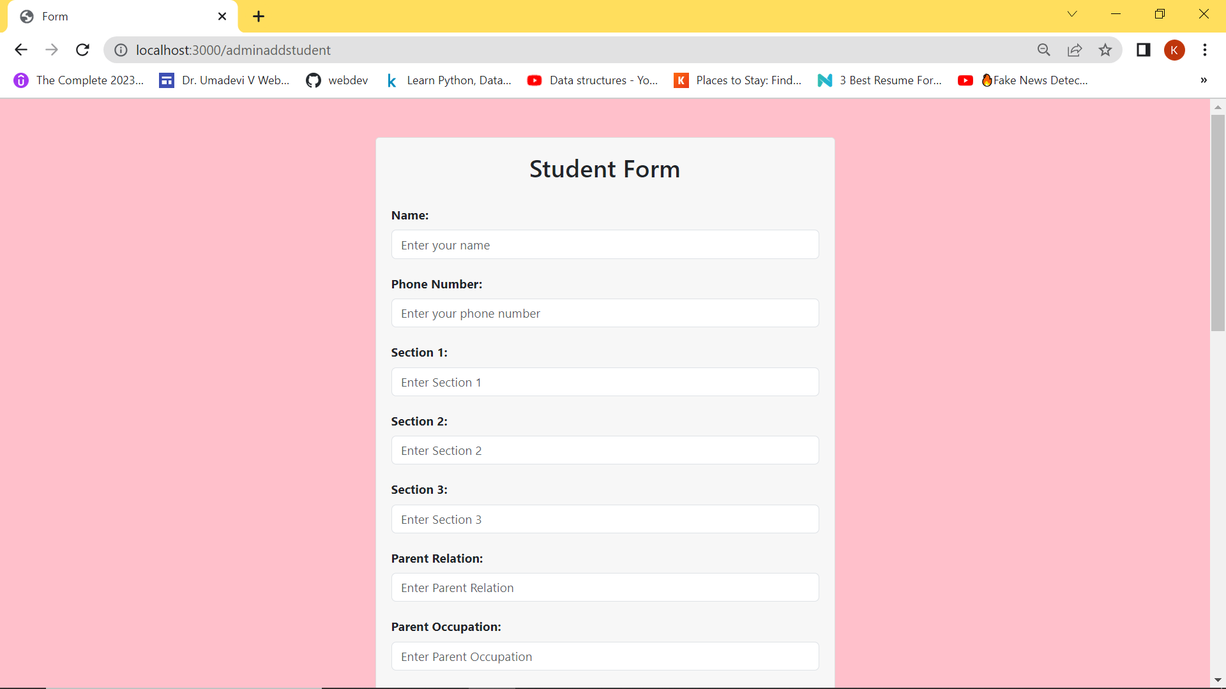
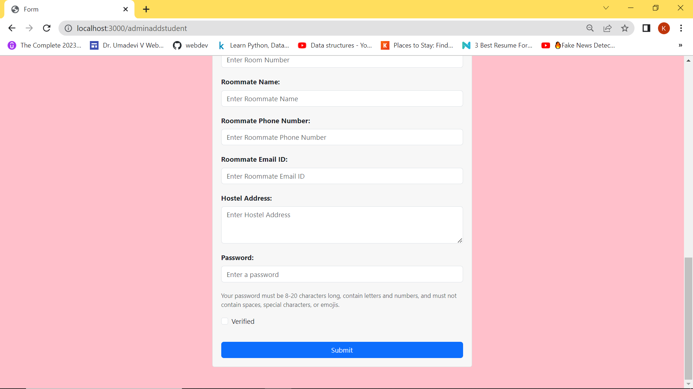
STUDENT FORM
1.This page include to add students’ details by admin.
2.Admin need to fill each detail given above.
3.To save the students press on the submit button.

Slide 23



MEET OUR TEAM member:
Kshitij s
Jigar d patel
KRISHN​ MALOO
1BM21CS093
1BM21CS081
1BM21CS092

Slide 24
SUMMARY
The hostel management system project aims to streamline and automate various administrative tasks involved in managing a hostel or similar accommodation facility. It provides a comprehensive solution to effectively manage hostel operations, including student registration, room allocation, fee management, various complaint form and reporting etc.

Slide 25
THANK YOU

